Slide 1
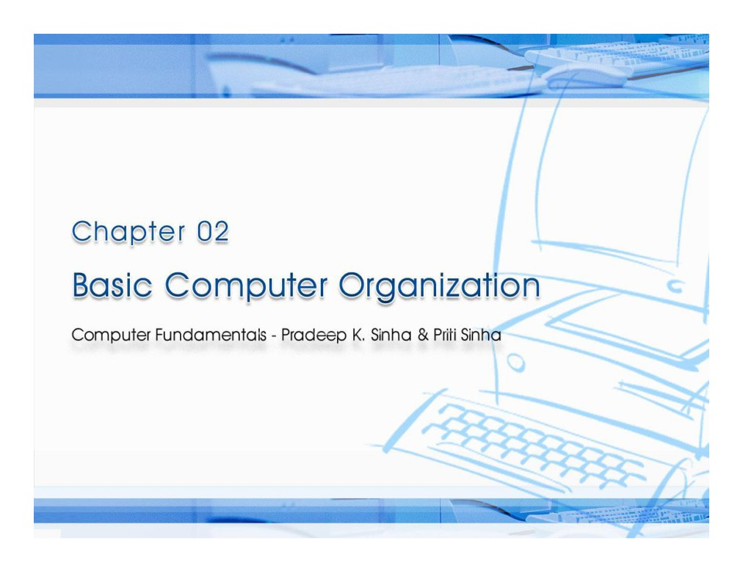

Slide 2

Computer Fundament ls: Pradeep K. Sinha & Priti Sinha
Learning Objectives
In this chapter you will learn about:
§ Basic operations performed by all types of computer
systems
§ Basic organization of a computer system
§ Input unit and its functions
§ Output unit and its functions
§ Storage unit and its functions
§ Types of storage used in a computer system
(Continued on next slide)
Ref. Page 15
Chapter 2: Basic Computer Organization
Slide 2/16

Slide 3
Computer Fundament
ls: Pradeep K. Sinha & Priti Sinha
Learning Objectives
(Continued from previous slide..)
§ Arithmetic Logic Unit (ALU)
§ Control Unit (CU)
§ Central Processing Unit (CPU)
§ Computer as a system
Ref. Page 15
Chapter 2: Basic Computer Organization
Slide 3/16

Slide 4
Computer Fundament ls: Pradeep K. Sinha & Priti Sinha
The Five Basic Operations of a Computer System
§ Inputting. The process of entering data and instructions
into the computer system
§ Storing. Saving data and instructions to make them
readily available for initial or additional processing
whenever required
§ Processing. Performing arithmetic operations (add,
subtract, multiply, divide, etc.) or logical operations
(comparisons like equal to, less than, greater than, etc.)
on data to convert them into useful information
(Continued on next slide)
Ref. Page 15
Chapter 2: Basic Computer Organization
Slide 4/16

Slide 5
Computer Fundament ls: Pradeep K. Sinha & Priti Sinha
The Five Basic Operations of a Computer System
§ Outputting. The process of producing useful information
or results for the user such as a printed report or visual
display
§ Controlling. Directing the manner and sequence in which
all of the above operations are performed
Ref. Page 15
Chapter 2: Basic Computer Organization
Slide 5/16

Slide 6
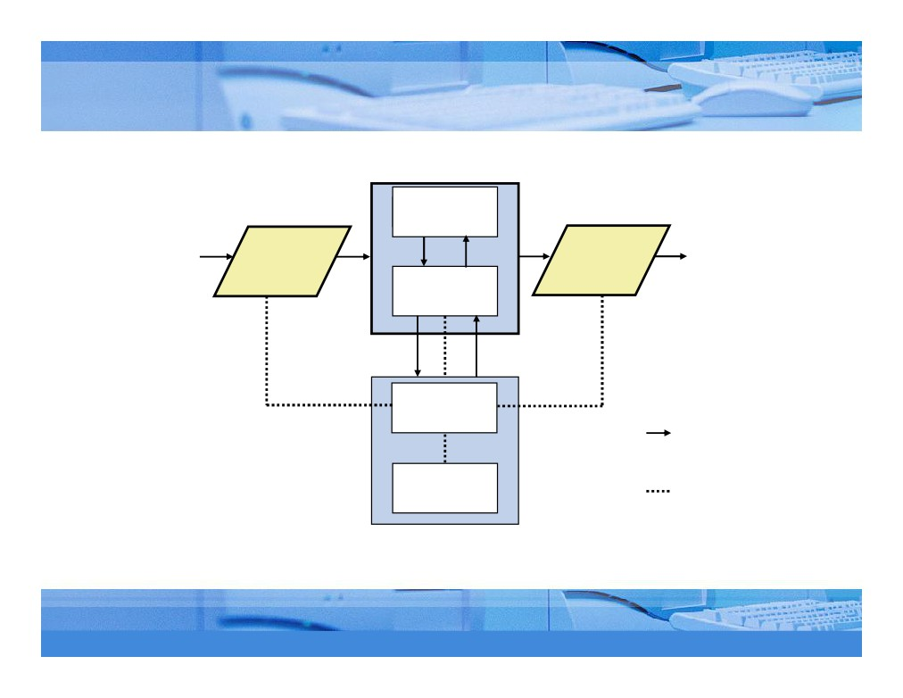
Computer Fundament ls: Pradeep K. Sinha & Priti Sinha
Basic Organization of a Computer System
Storage Unit
Secondary
Storage
Program
Input Output
Information
(Results)
and
Unit Unit
Data
Primary
Storage
Control
Unit
Indicates flow of
instructions and data
Arithmetic
Logic Unit
Indicates the control
exercised by the
control unit
Central Processing Unit (CPU)
Ref. Page 16
Chapter 2: Basic Computer Organization
Slide 6/16

Slide 7
Computer Fundament ls: Pradeep K. Sinha & Priti Sinha
Input Unit
An input unit of a computer system performs the
following functions:
1. It accepts (or reads) instructions and data from outside
world
2. It converts these instructions and data in computer
acceptable form
3. It supplies the converted instructions and data to the
computer system for further processing
Ref. Page 16
Chapter 2: Basic Computer Organization
Slide 7/16

Slide 8
Computer Fundament ls: Pradeep K. Sinha & Priti Sinha
Output Unit
An output unit of a computer system performs the
following functions:
1. It accepts the results produced by the computer, which
are in coded form and hence, cannot be easily
understood by us
2. It converts these coded results to human acceptable
(readable) form
3. It supplies the converted results to outside world
Ref. Page 16
Chapter 2: Basic Computer Organization
Slide 8/16

Slide 9
Computer Fundament ls: Pradeep K. Sinha & Priti Sinha
Storage Unit
The storage unit of a computer system holds (or stores)
the following :
1. Data and instructions required for processing (received
from input devices)
2. Intermediate results of processing
3. Final results of processing, before they are released to
an output device
Ref. Page 17
Chapter 2: Basic Computer Organization
Slide 9/16

Slide 10
Computer Fundament ls: Pradeep K. Sinha & Priti Sinha
Two Types of Storage
§ Primary storage
§ Used to hold running program instructions
§ Used to hold data, intermediate results, and
results of ongoing processing of job(s)
§ Fast in operation
§ Small Capacity
§ Expensive
§ Volatile (looses data on power dissipation)
(Continued on next slide)
Ref. Page 17
Chapter 2: Basic Computer Organization
Slide 10/16

Slide 11
Computer Fundament ls: Pradeep K. Sinha & Priti Sinha
Two Types of Storage
(Continued from previous slide..)
§ Secondary storage
§ Used to hold stored program instructions
§ Used to hold data and information of stored jobs
§ Slower than primary storage
§ Large Capacity
§ Lot cheaper that primary storage
§ Retains data even without power
Ref. Page 17
Chapter 2: Basic Computer Organization
Slide 11/16

Slide 12
Computer Fundament ls: Pradeep K. Sinha & Priti Sinha
Arithmetic Logic Unit (ALU)
Arithmetic Logic Unit of a computer system is the place
where the actual executions of instructions takes place during
processing operation
Ref. Page 18
Chapter 2: Basic Computer Organization
Slide 12/16

Slide 13
Computer Fundament ls: Pradeep K. Sinha & Priti Sinha
Control Unit (CU)
Control Unit of a computer system manages and coordinates
the operations of all other components of the computer
system
Ref. Page 18
Chapter 2: Basic Computer Organization
Slide 13/16

Slide 14
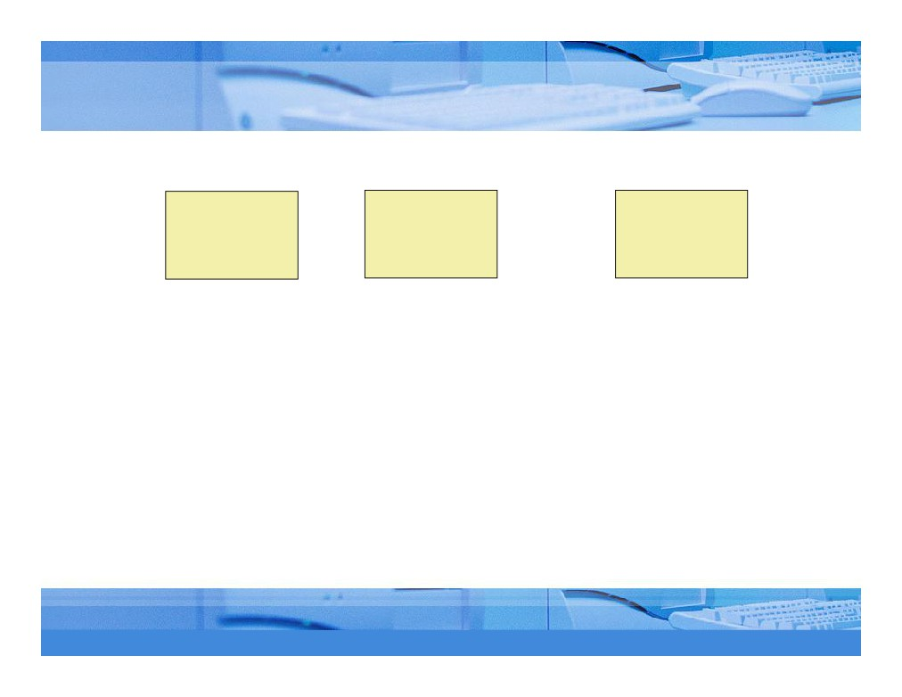
Computer Fundament ls: Pradeep K. Sinha & Priti Sinha
Central Processing Unit (CPU)
Arithmetic
Logic Unit
Central
+
Control Unit
=
Processing
Unit (CPU)
(ALU)
(CU)
§ It is the brain of a computer system
§ It is responsible for controlling the operations of
all other units of a computer system
Ref. Page 18
Chapter 2: Basic Computer Organization
Slide 14/16

Slide 15
Computer Fundament ls: Pradeep K. Sinha & Priti Sinha
The System Concept
A system has following three characteristics:
1. A system has more than one element
2. All elements of a system are logically related
3. All elements of a system are controlled in a manner to
achieve the system goal
A computer is a system as it comprises of integrated
components (input unit, output unit, storage unit, and CPU)
that work together to perform the steps called for in the
executing program
Ref. Page 18
Chapter 2: Basic Computer Organization
Slide 15/16

Slide 16
Computer Fundament ls: Pradeep K. Sinha & Priti Sinha
Key Words/Phrases
§ Arithmetic Logic Unit (ALU)
§ Auxiliary storage
§ Output interface
§ Output unit
§ Central Processing Unit (CPU)
§ Computer system
§ Outputting
§ Primate storage
§ Processing
§ Control Unit (CU)
§ Controlling
§ Secondary storage
§ Storage unit
§ Input interface
§ Input unit
§ Storing
§ Inputting
§ Main memory
§ System
Ref. Page 19
Chapter 2: Basic Computer Organization
Slide 16/16

